Slide 1

PYTHON VARAIABLES

Slide 2

OBJECTIVES
About Variables.
Variable assignment
Different types of Variable.

Slide 3
Variables
Hold values
The act of assignment to a variable allocates the name and space for the variable to contain a value.
Do not require forward declaration
Built-in type() function can be used to track what kind of value is stored in a variable.
We can also assign None to a variable, this is known as not a type, or none type variable.
The “isequal” operator is used to check if two variables are identical.

Slide 4
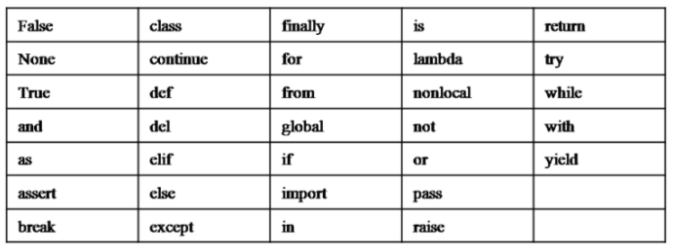
KEYWORDS

Slide 5

SUMMARY
Variables are the boxes of memory holding some value.
In python we do not need to forward declare any variable.

